Slide 1
Peninsula Agency on Aging, Inc. (PAA)
William S. Massey, CEO
739 Thimble Shoals Blvd
Newport News, VA 23606
757-873-0541
paainc.org

Slide 2
Decisions
Huge decisions were made in the
1930s “New Deal”
1965-67 “Great Society”
1965 Medicare, Medicaid, OAA
2011 We are facing decisions of the same magnitude
Life Expectancy
1935 – 62 yrs 1965 – 69 yrs 2011 – 78 yrs

Slide 3
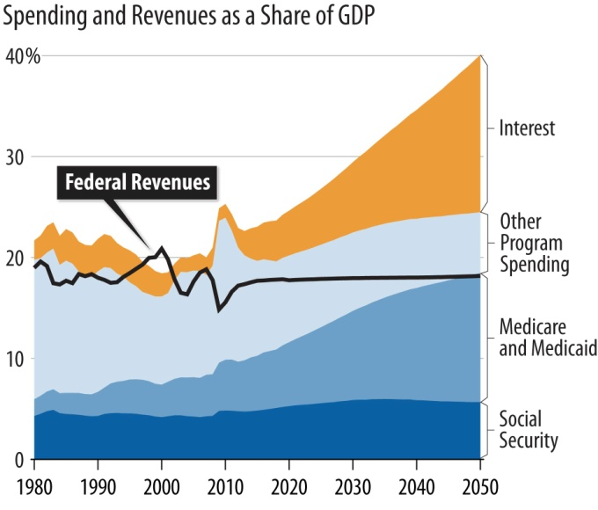
Medicare and Medicaid Expected to Rise Rapidly, Other Programs (Except Social Security) to Shrink, As Share of GDP
Spending and Revenues as a Share of GDP
Source: CBPP projections based on CBO data.

Slide 4
Challenges of Aging
Illness – dementia, diabetes, stroke
Mobility – driving, transportation
Safety – identity theft, scams
People are outliving their money
Isolation, depression
Caregiver stress
There are resources…..
Notes:
This trend will present challenges

Slide 5
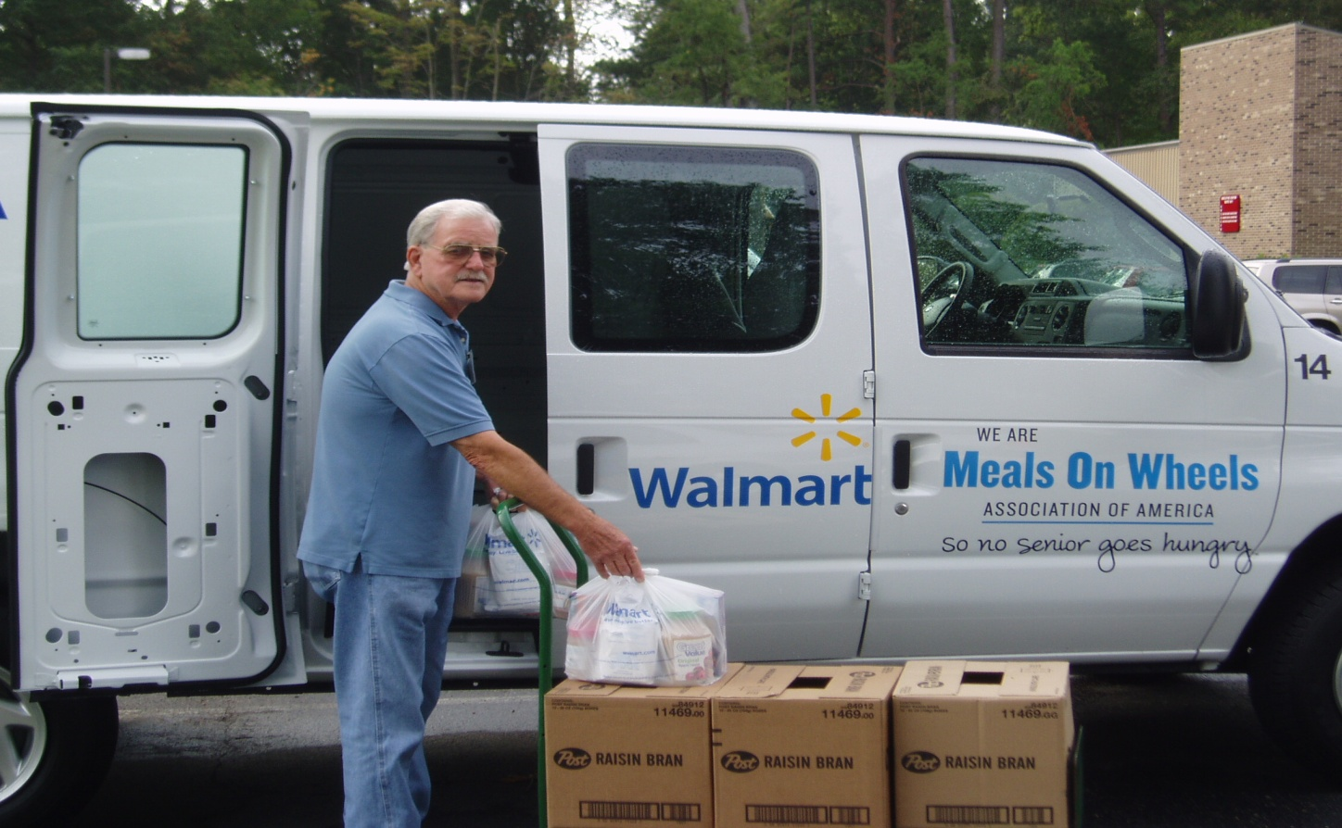
PAA is here to help

Slide 6
PAA Mission
To support the independence and quality of life for Peninsula residents age 60 and older by advocating, arranging or providing vital human services.
Help seniors live independent and healthy lives in their own homes as long as possible.
Notes:
PAA gives hope. Their mission is to support independence and quality of life. Give personal example of what this means e.g. own mother.

Slide 7
History and Background
PAA was founded in 1974 to serve senior citizens on the Peninsula.
PAA is a non-profit organization and an Area Agency on Aging (AAA)
PAA is one of 25 AAA’s in Virginia.

Slide 8
PAA
Geographical Area: Newport News, Hampton, Williamsburg, James City County, York County and Poquoson
Funding: Federal, State, and local governments, United Way, private contributions, foundations and client fees
Twelve member Board of Directors governs with Advisory Council input
Notes:
PAA is designated by the Virginia Department for the Aging as the Area Agency on Aging and is one of 25 in Virginia and part of a Nationwide Network of 670 Area Agencies on Aging.

Slide 9
FY 2012 PENINSULA AGENCY ON AGING, INC. BOARD OF DIRECTORS
-Ingo J. Humer -Louis G. Kopp -Marilyn L. Kuhn
Secretary/Treasurer Hampton Poquoson
Newport News
-Jerome A. Provenzano -Doris Mosocco -Ann B. Wilson
Vice Chairman Newport News Newport News
York County
-Robert W. Spencer -Marion M. Ross -Jason Samuels
Chairman Williamsburg Advisory Council Chairman
James City County Hampton
-Mary Stewart
Newport News

Slide 10
Peninsula Agency on Aging Endowment Foundation, Inc. Board of Directors
-James W. Funk
-Jeremy C. Johnson
-Deborah Kratter
-William S. Massey
-Ann McGee
-Margaret Lee Overton

Slide 11
Area Agencies on Aging
There are over 655 AAA’s nationwide.
To locate an area agency nationwide, call the Elder Care Locator at 1-800-677-1116 or call PAA at 757-873-0541.
Notes:
2007 Annual Report. PAA is monitored by the VA Agency on Aging.

Slide 12
PAA’s Clients
In 2010 PAA provided services to 4,082 senior citizens:
65 % live alone
31 % below poverty
68 % impoverished
Average age is 79 years
Notes:
2007 Annual Report

Slide 13
PAA Services
Social Work:
Information and Referral Services
In Home Assessment
Personal Care, Adult Day Care Assistance
Caregiver Support
Senior Outreach to Services (SOS)
Health Promotion and Disease Prevention
Notes:
Core services include: Social Work, Community Service and No Wrong Door (NWD)
Outreach through sponsoring conferences, participating in Health Fairs and groups for
Alzheimer’s Support Group facilitation.
Caregiver support by facilitating a Support Group for Caregivers and publishing a monthly newsletter.

Slide 14
PAA Services
Community Services
Home Delivered Meals or Meals on Wheels for homebound elderly who have no family support during the day.
Senior Dining Centers at 8 locations. Noon meal served weekly.
Transportation services – to MD appointments and treatment, adult daycare facilities, and group dining sites.

Slide 15
PAA Services
Peninsula Aging & Disability Resource Network (PADRN) www.padrn.org
A regional “one-stop” approach to ensure same access to information and resources for long-term support services regardless of their point of entry into the system
Share and coordinate client information, service referral and case management in compliance with privacy issues.
Follows the national ADRC initiative.
Notes:
Conference for this year is March 11 at Christopher Newport University.

Slide 16
Volunteer Opportunities
Over 1,400 volunteers in 2010 who dedicated 26,236 hours of service
Deliver Meals on Wheels
Transport seniors to medical appointments
Assist with activities for seniors in Senior Dining Centers
Perform office work at PAA

Slide 17
PAA In Conclusion
Our Impact
Access to Health Care
Increase knowledge of services
Help seniors extend their resources
Caregiver support
Maintain or improve quality of life for elders and their caregivers

Slide 18
How can the VPEPC
become involved?
Share information about the opportunity to invest in the quality of life for Peninsula seniors

Slide 19
Resources for More Information
Peninsula Aging & Disability Resource Network (PADRN) – www.padrn.org
VA Department for the Aging – www.vda.virginia.org
The Center for Excellence In Aging and Geriatric Health (CEAGH) – www.excellenceinaging.org
Notes:
Clinical Research & Projects
Driver Evaluation
Memory Assessment Clinic
Clinical Research & Projects
Driver Evaluation
Memory Assessment Clinic

Slide 20
Any Questions?
PAA at 757-873-0541
www.paainc.org

